Slide 1
Telerik Testing Framework
Software Quality Assurance
Telerik Software Academy
http://academy.telerik.com

Slide 2

The Lecturer
Dimitar Topuzov
Senior QA Engineer
@NativeScript Team
Resources:
Email:
https://github.com/dtopuzov/qa-academy
Dimitar.Topuzov@Telerik.com

Slide 3

Table of Contents
Telerik Testing Framework Intro
Telerik Testing Framework Features
TTF vs. Test Studio
TTF vs. Selenium WebDriver
Telerik Testing Framework Demos
Testing web sites
Testing WPF applications

Slide 4
Telerik Testing Framework
Free .NET API for test automation
Support Web (HTML, JavaScript, Ajax, …)
Support Silverlight Applications
Support WPF Applications
Include some nice extras like
Browser abstraction
Wrappers for Telerik Rad Controls
Build-in handlers for Popups and Browser Dialogs
Element identification using LINQ

Slide 5
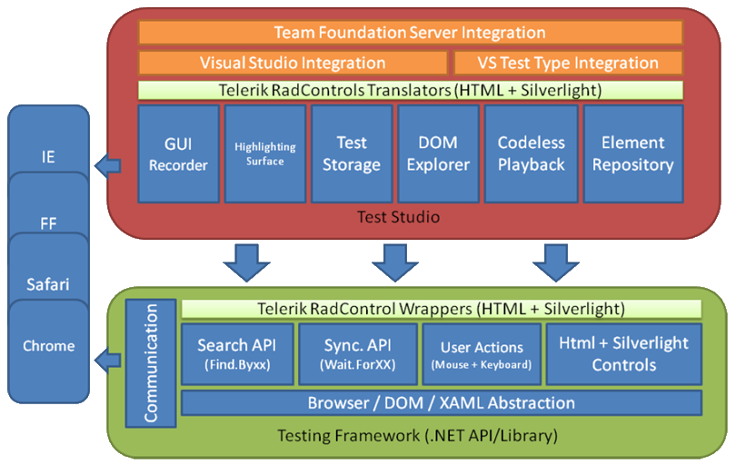
Telerik Testing Framework vs. Test Studio

Slide 6
Telerik Testing Framework vs. Selenium
 | Telerik Testing Framework | Selenium WebDriver
Multi-browser support | Yes | Yes
Headless Browsers support | No | Yes
Silverlight | Yes | No
WPF | Yes | No
Language | C#, VB .NET | Java, C#, Python, Ruby, Java Script

Slide 7
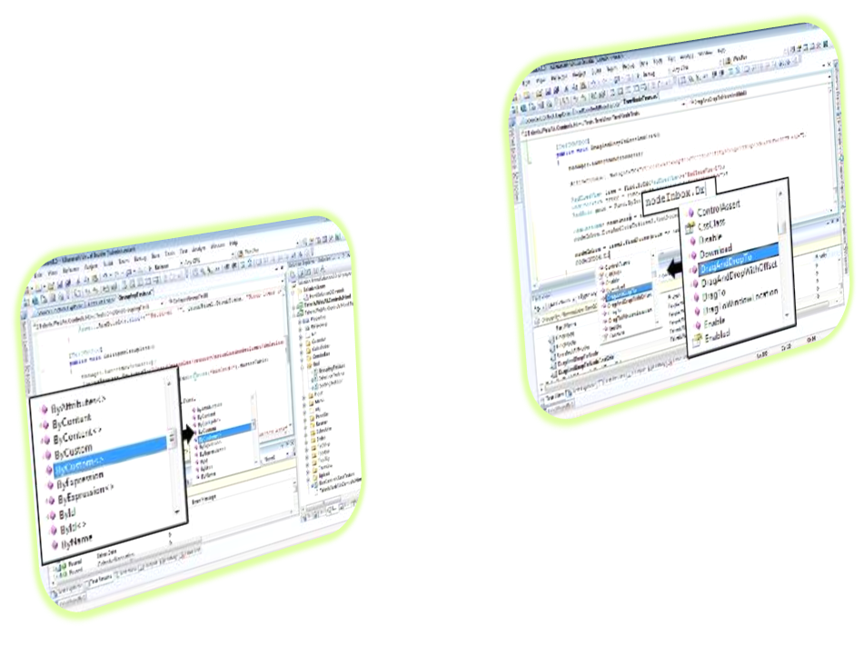
Testing Web (Demo)
Getting started
Manager, Browser and Settings objects
Locate elements
Find.* methods
HtmlFindExpressions
Linq
Perform actions
Methods of HtmlControls
KeyBoard and Mouse classes

Slide 8
Testing WPF (Demo)
Getting started
Inspect WPF visual tree
Start/Connect WPF application
Locate elements
Find.* methods
XamlFindExpression
Linq
Perform actions
Methods of FrameworkElements

Slide 9
Telerik Testing Framework
?
?
?
?
?
Questions?
?
?
?
?
?
?

Slide 10




Free Trainings @ Telerik Academy
C# Programming @ Telerik Academy
csharpfundamentals.telerik.com
Telerik Software Academy
academy.telerik.com
Telerik Academy @ Facebook
facebook.com/TelerikAcademy
Telerik Software Academy Forums
forums.academy.telerik.com

